Slide 1

Reddit
Team High Five and Dive
By Adrian, John, and Anthony

Slide 2

What is Reddit?
Reddit is a Social Network of users who share in the same passions, interests, and thoughts. Members can join and contribute (post) to different communities (such as Space, for example) in which they are interested in. These communities are called subreddits, and each subreddit is overseen by moderators.
Notes:
John

Slide 3

Communities
All across reddit there are shared interests in certain topics and ideas to enjoy. Ranging from any from funny videos to fan bases. These communities gather many like minded individuals. Allowing them to interact without having to deal with problems on other social media sites that involve their policies and negative commentary from other accounts.
Notes:
Anthony

Slide 4
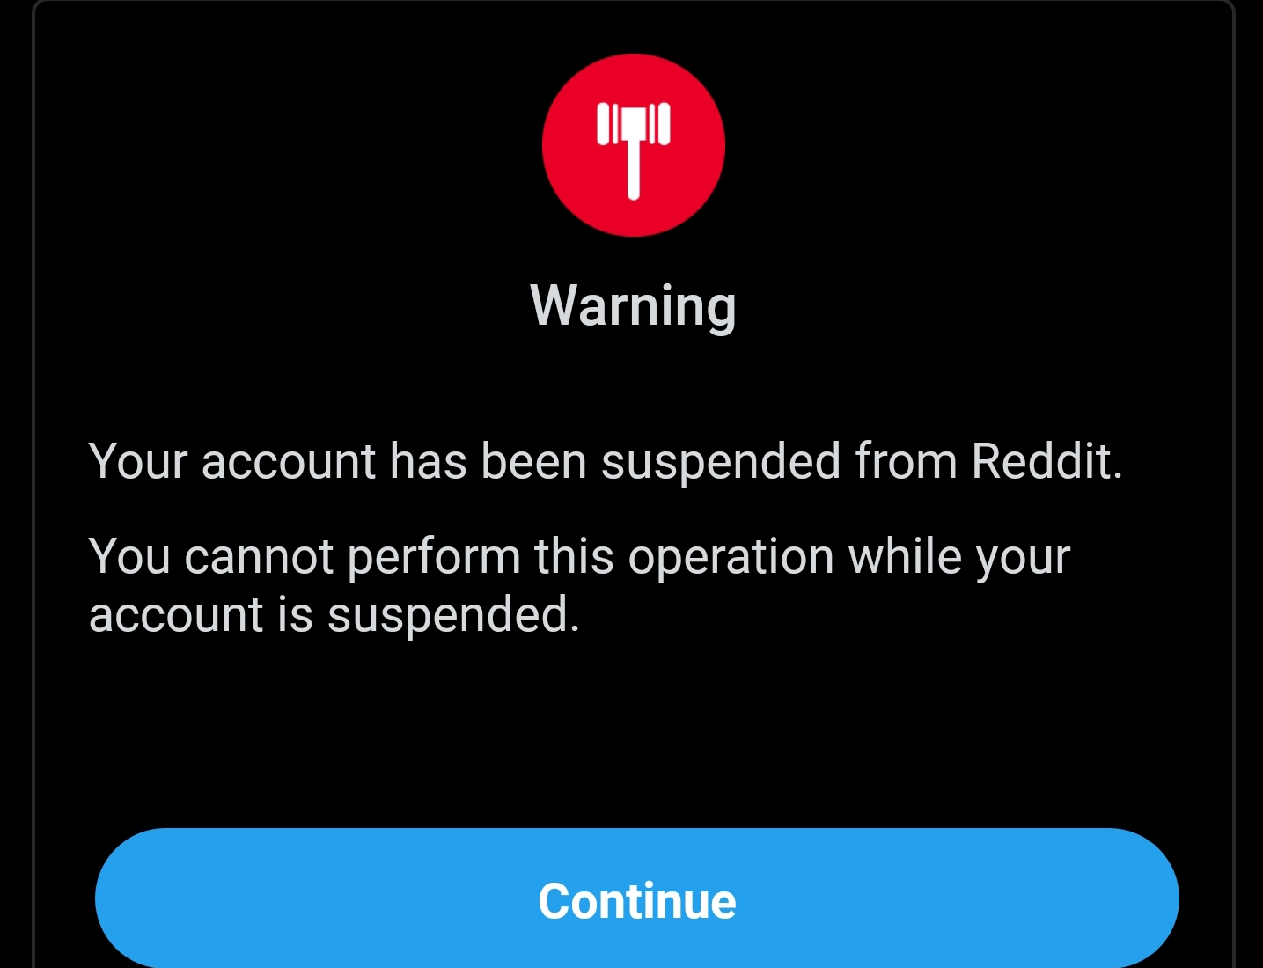
Moderators
Moderators are volunteers for a particular subreddit who monitor all of the content posted to that sub. They can delete posts and temporarily or even permanently ban a user from that subreddit. They keep things on topic and maintain the quality of posts.
Notes:
John

Slide 5

Awards
Reddit introduces awards that are available to purchase through microtransactions. Those who are receiving and giving awards get a certain amount of karma based on how expensive the award was to buy.
Notes:
Adrian

Slide 6

Karma
Karma on Reddit is a score that you receive from your post and comment history, as well as from getting or receiving awards. On posts/comments on Reddit, there is an upvote arrow and a downvote arrow. All of these together give you a Post Karma number and a Comment Karma number. With higher Karma, a user can post more often and post in more subreddits.
Notes:
John

Slide 7

Information Sharing
Reddit was created to spread information freely amongst it members. Allowing them to add whatever information they want without the fear of it being flagged or removed because of it content. As long as it stay on topic in its designated community and follows its rules it will not be removed.
Notes:
Anthony

Slide 8

Limitless Potential
Reddit allows for a diverse and versatile social platform that awards its users for using it. There are an infinite number of communities that could possibly be made, from broad topics to ones that are oddly specific. You have freedom to do whatever you want, so long as the community says so. Whether its normal or questionable ideas and content, reddit will never censor or restrict.
Notes:
Adrian

